Slide 1



SAPTHAGIRI COLLEGE OF ENGINEERING
(Affiliated to Visvesvaraya Technological University, Belagavi & Approved by AICTE, New Delhi.)
Department of Computer Science & Engineering
Sugarcane Crop-Support System
Presented By :
ASHWIN RAMESH P | 1SG16CS016
BINDHU M V | 1SG16CS020
DIVIJ N | 1SG16CS029
DIVYA K | 1SG16CS030
Under the Guidance Of :
Prof. Anuradha Badage
Assistant Professor,
Dept. of CSE.

Slide 2
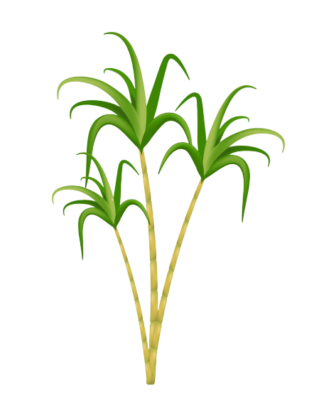
Abstract
Sugarcane crop is grown in more than 90 countries and accounts upto 70% of sugar . Along with the diversity in the crop there is a huge spectrum of disease the plant can acquire.
The system is designed for accurate detection and suggestion of appropriate remedial measures.

Slide 3

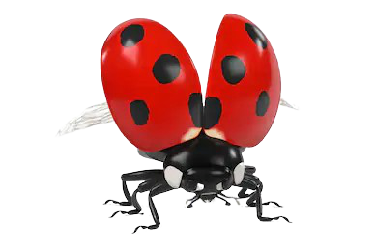
INTRODUCTION
Sugarcane is the world's largest crop by production quantity, with 1.9 billion tonnes produced in 2016.
It is cultivated on about 26 million hectares.
Primarily grown in Brazil, India, China and Thailand.
Pests, insects, pathogens infect the plants resulting in decrease in the production to large scale if not controlled within time.

Slide 4
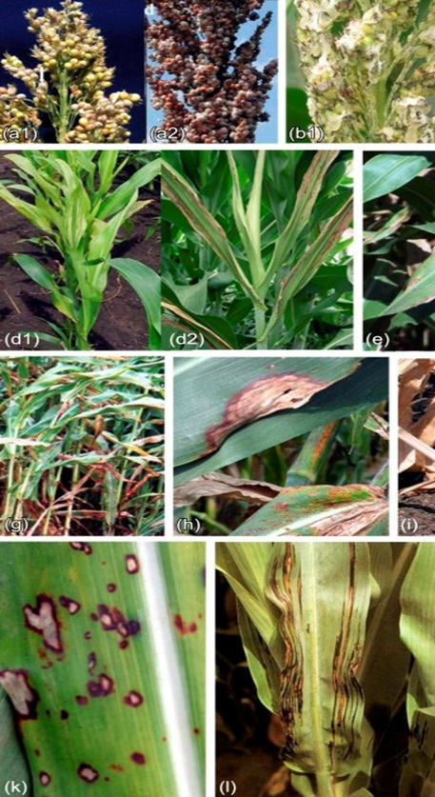
PROBLEM STATEMENT
To design and develop a system for detection and prevention of major sugarcane diseases.

Slide 5


Methodology
Image Aquisition
Image Augmentation and Preprocessing
Pre-Trained Model
Android Application
Tensor Flow Lite Convertor
Input Image
Result

Slide 6
Implementation
Image Acquisition :
Appropriate datasets are required
Image Augmentation and Preprocessing :
Artificially expand the data-set.
Resize, remove background noise etc from the images.
Pre-Trained Model :
The preprocessed images fed to pre-trained model.
This trained model is then obtained as the saved model.

Slide 7
IMPLEMENTATION
Tensor Flow Lite Convertor :
Convert Saved model file to ‘*.tflite’.
Android Application :
The farmer uploads the image of plant.
Input image is classified by executing the .tflite file.
Return Mapped output through android app.

Slide 8
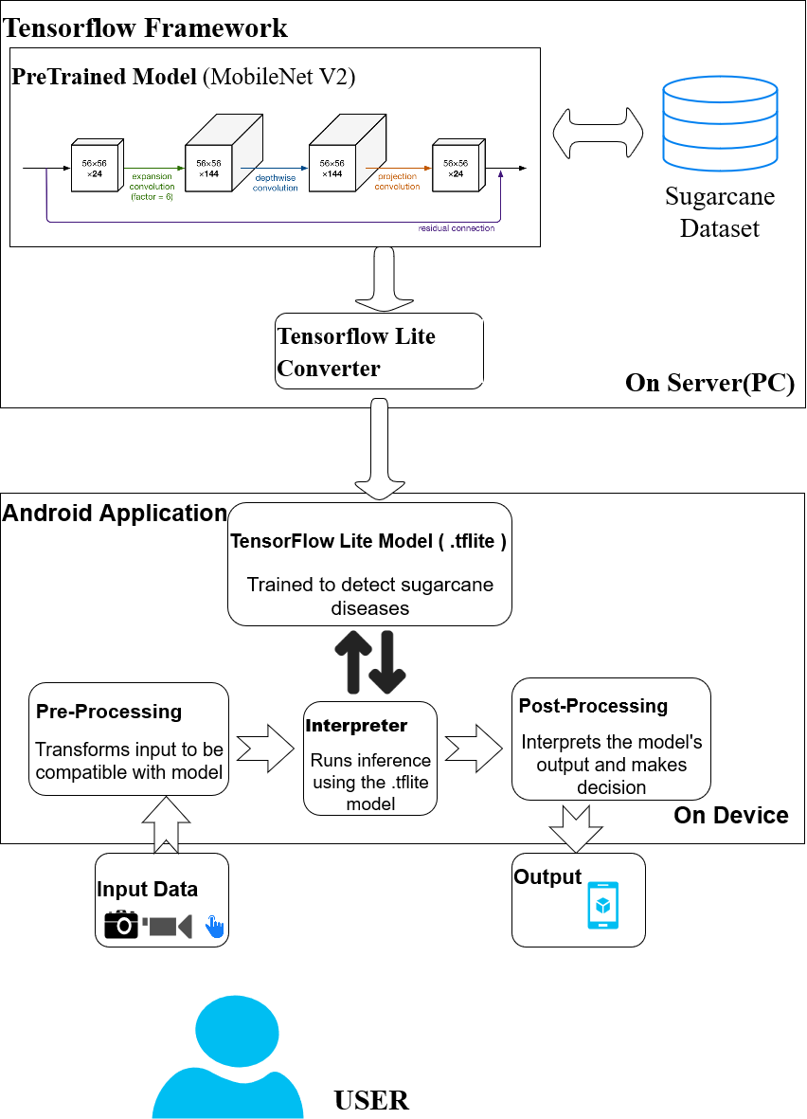
System architecture

Slide 9
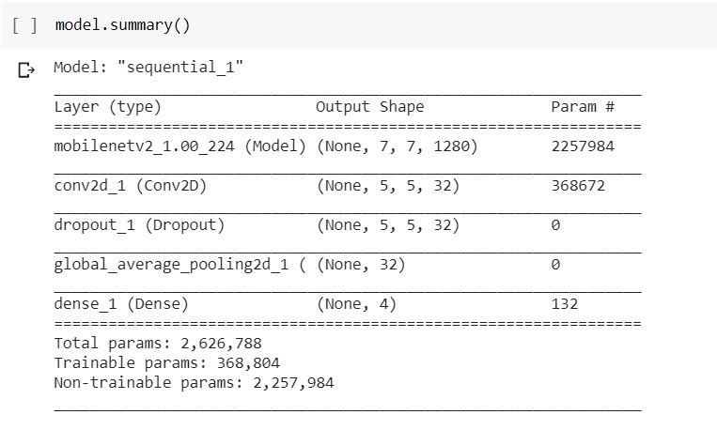
Model summary

Slide 10
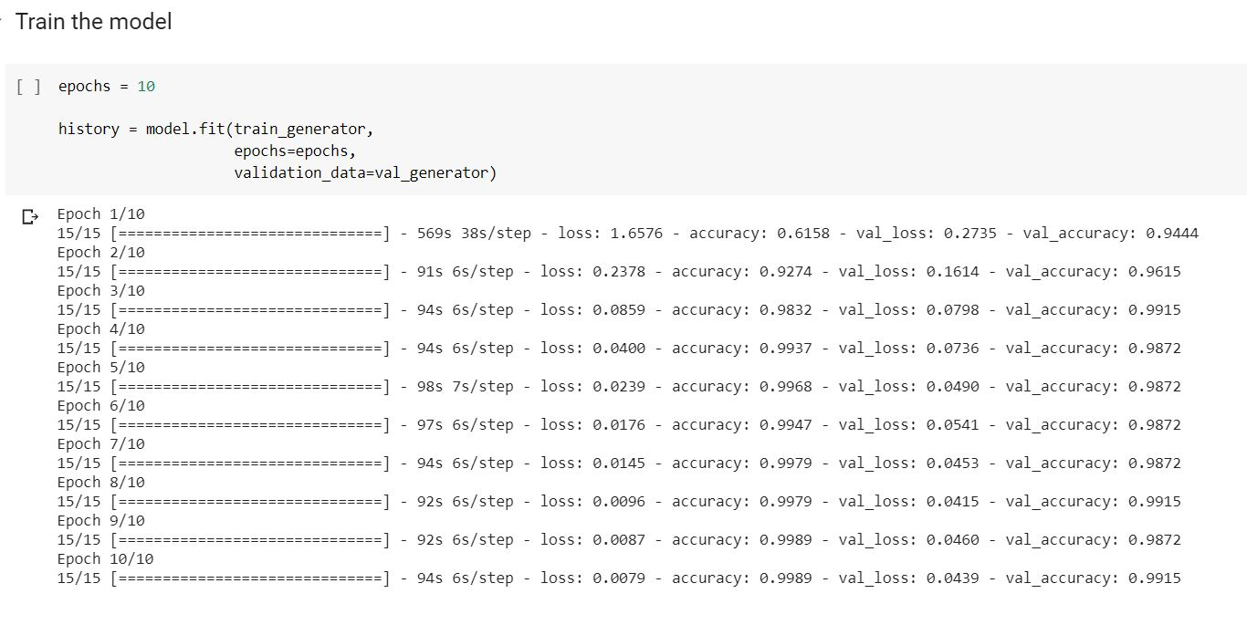
Model training

Slide 11
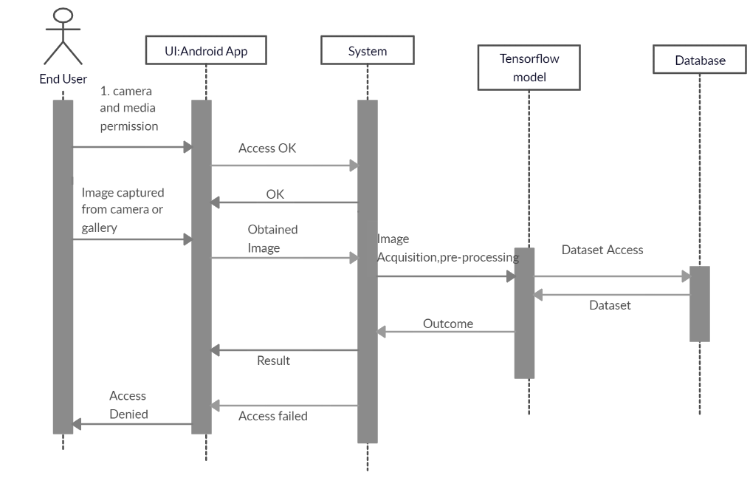
Sequence diagram

Slide 12

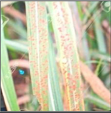
Test cases
IMAGE SELECTED | EXPECTED OUTCOME | OBTAINED OUTCOME | TEST CASE OUTCOME
 | No Disease Detected | No Disease Detected | PASS
 | RED ROT DISEASE | RED ROT DISEASE DETECTED | PASS

Slide 13
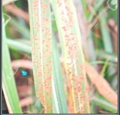
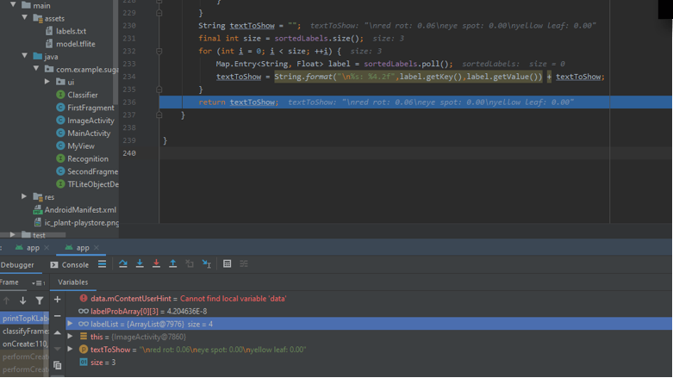
Android output
IMAGE
OUTPUT

Slide 14

Android output
IMAGE
OUTPUT

Slide 15
CONCLUSION
Interactive UI for real time users
Accurate prediction of disease
Suggesting Remedial measures
On Device Inference

Slide 16
THANK YOU

